Slide 1
Introductory Algebra
By the end of this lesson you will be able to explain and calculate the following:
What is a pronumeral
How to form an expresion/equation
Algebra: Algebra & Equations

Slide 2
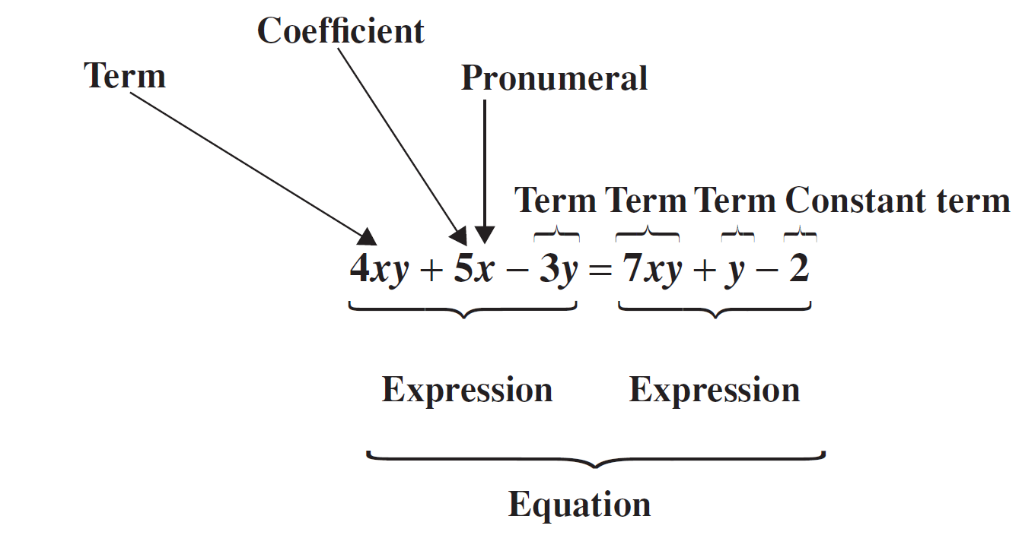
Algebra

Slide 3
Using Pronumerals
The basic purpose of algebra is to solve mathematical problems involving an unknown.
Equations where an unknown quantity is replaced with a letter (for example, x) can be used to solve problems like:
At what speed should I ride my bicycle to arrive at school on time?
How do I convert a recipe for different numbers of guests?
What volume of concrete is needed to build a path?

Slide 4
Using Pronumerals
A pronumeral is a letter that is used in place of a number.
Often a pronumeral is used to represent one particular number.
For example, in the equation x + 1 = 7 the pronumeral x has the value 6.
Pronumerals can also be used to show a relationship between two or more numbers.
For example, a + b = 10
Can you find some different pairs of values for a and b that fit this rule?

Slide 5
Algebra
Algebra allows us to show complex rules in a more simple way and to solve problems involving unknown numbers.
In algebraic expressions pronumerals are known as variables
Because the value of the pronumeral may be varied to represent any number.
In algebraic equations, pronumerals are referred to as unknowns
Because the pronumeral represents a specific value that is not yet known.

Slide 6
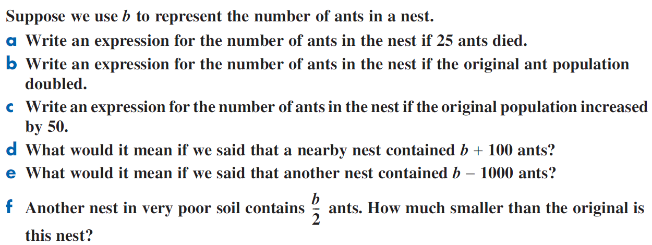
Worked Example

Slide 7
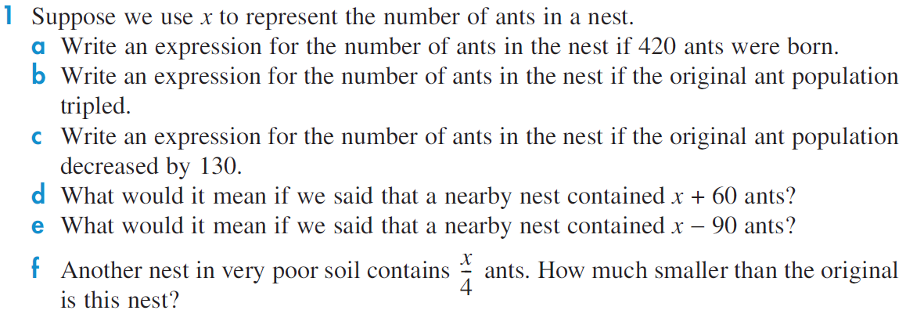

Slide 8
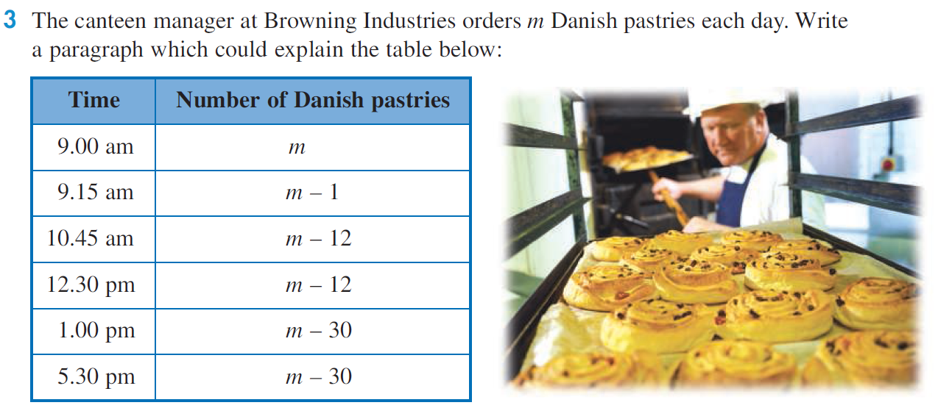

Slide 9
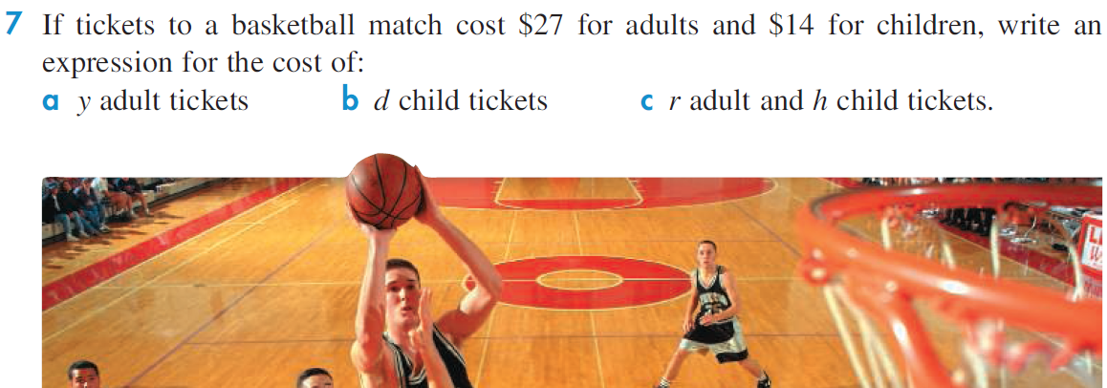

Slide 10
Substitution
When a pronumeral is replaced by a number, we say that the number is substituted for the pronumeral.
If the value of the pronumeral is known, it is possible to evaluate an expression by using substitution
For example, if we know that x = 2 and y = 3, the expression x + y can be evaluated as shown:
x + y = 2 + 3 = 5

Slide 11
Substitution
When writing expressions with pronumerals, it is important to remember the following points:
The multiplication sign is omitted.
For example: 8n means ‘8×n’ and 12ab means ’12×a×b’.
The division sign is rarely used.
For example, y ÷ 6 is shown as

Slide 12
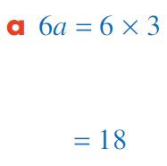
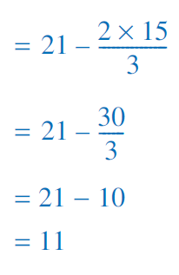
Worked Example

Slide 13
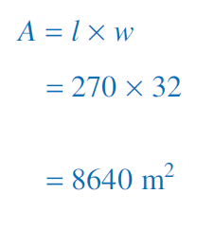
Worked Example

Slide 14
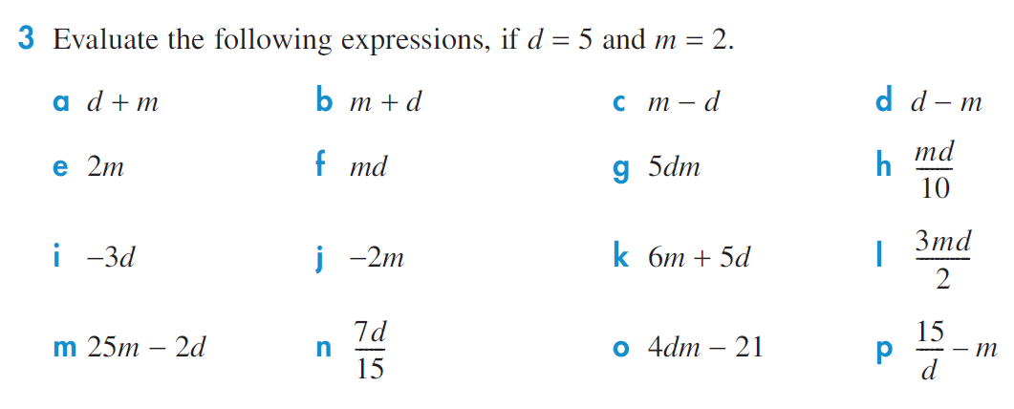

Slide 16
Working with brackets
Brackets are grouping symbols.
The expression 3(a + 5) can be thought of as:
‘three groups of (a + 5)’, or
(a + 5) + (a + 5) + (a + 5).
When substituting into an expression with brackets, remember to place a multiplication (×) sign next to the brackets. For example,

Slide 17
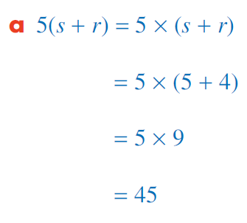
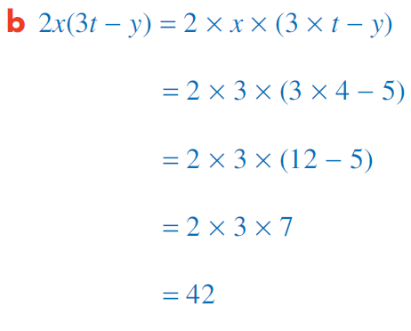
Worked Example

