Slide 1
Decimals
Number: Rational Numbers & Indices
By the end of this lesson you will be able to explain/calculate the following:
Decimal Place Values
Converting decimals to fractions
Converting decimals to percentage

Slide 2
Decimal Places
Decimals play such a big part of everyday life that:
we need to be able to use them,
put them in order, and,
convert them to simple fractions or percentages.

Slide 3
Ordering Decimals
Ascending order means from lowest to highest
Descending order means from highest to lowest

Slide 4
Ordering Decimals
This is done by first writing each number with the same number of decimal places, adding zeros where necessary.
We then look at the left-most digit.
The greater this digit, the greater the decimal number.
If the left-most digits are the same, we move to the next digit, and so on.

Slide 5
Worked Example

Slide 6
Terminating Decimals
Terminating decimals have a fixed or finite number of decimal places and can be written as a fraction with a denominator that is a power of 10.
If the decimal has 1 decimal place, the denominator of the fraction is 10;
If there are 2 decimal places, the denominator is 100;
If there are 3 decimal places, the denominator is 1000 and so on.
In each case the numerator is the decimal without the decimal point.
These fractions are simplified where possible.

Slide 7
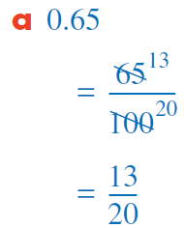
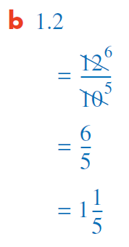
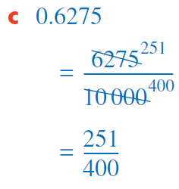
Worked Example

Slide 8
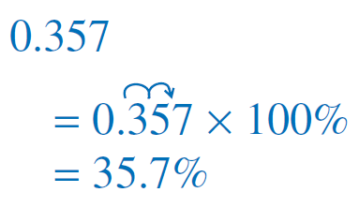
Converting decimals to percentage
To convert a decimal to a percentage we multiply the decimal by 100 and include the % sign.

Slide 9
Decimals – Key Points
To order decimals, write each with the same number of decimal places and compare.
To write terminating decimals as fractions, make the denominator an appropriate power of 10 and simplify where possible. The number of zeros in the denominator should be the same as the number of digits after the decimal point.
To convert a decimal to a percentage, multiply by 100 and include the percentage sign.

Slide 10
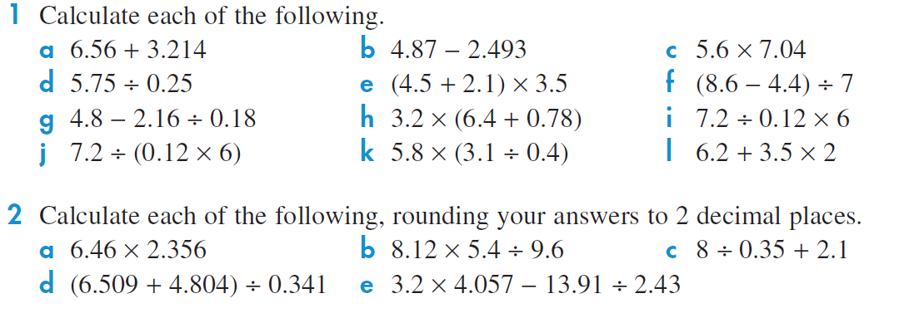

Slide 12
