Slide 1
You will have 60 Seconds to answer each question before it goes of the screen.
Don't get stuck on 1question
If you don't know leave it

Slide 2
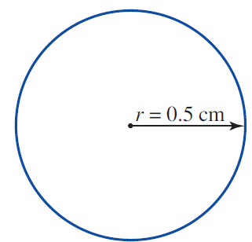

Slide 4
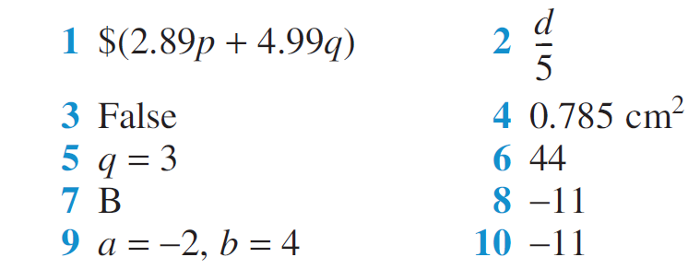

Slide 5
Number laws and pronumerals
By the end of this lesson you will be able to explain and calculate the following:
Commutative Law
Associative Law
Identity Law, and,
Inverse Law
Algebra: Algebra & Equations

Slide 6
Number laws and pronumerals
When dealing with any type of number, particular rules must be obeyed.
This lesson will investigate whether these rules also apply to pronumerals.
We will look at the following laws:
Commutative Law
Associative Law
Identity Law, and,
Inverse Law

Slide 7
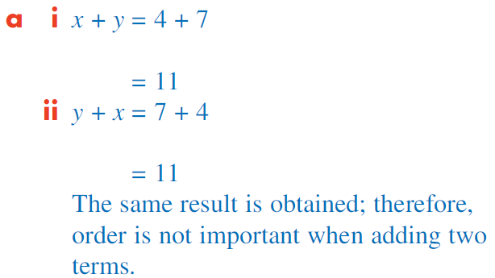
Commutative Law
The Commutative Law refers to the order in which two numbers may be + , – , x or ÷.

Slide 8
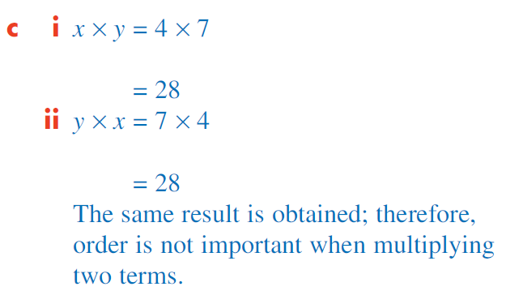
Worked Example – cont.

Slide 9
Commutative Law
The Commutative Law holds true for addition (and multiplication) because the order in which two numbers or pronumerals are added (or multiplied) does not affect the result.
Therefore, in general,
x + y = y + x
x − y ≠ y − x
x × y = y × x
x ÷ y ≠ y ÷ x

Slide 10
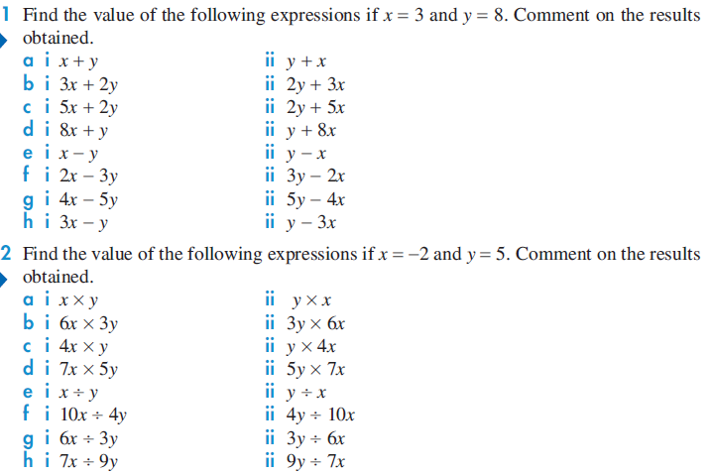
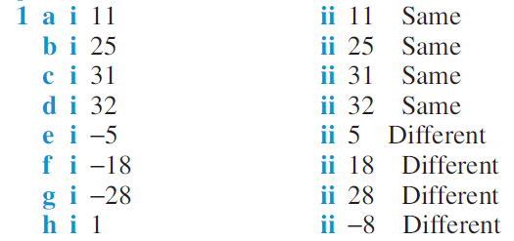
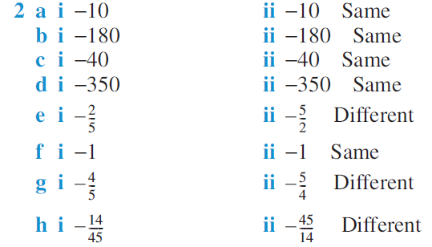

Slide 12
Associative Law
The Associative Law refers to the order in which three numbers + , – , x or ÷, taking two at a time.

Slide 13
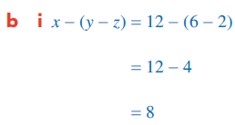
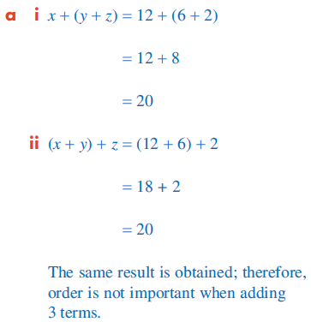
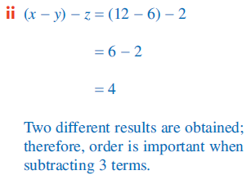
Worked Example

Slide 14
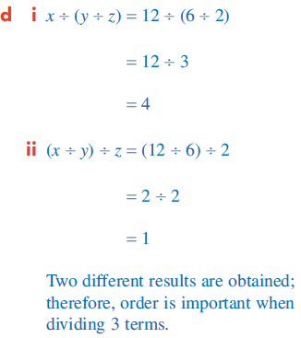
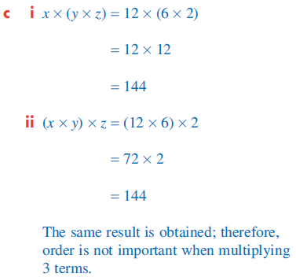
Worked Example

Slide 15
Associative Law
The Associative Law holds true for addition (and multiplication) because the order in which three numbers or pronumerals, taking two at a time, are added (or multiplied) does not affect the result.
Therefore, in general,
x + (y + z) = (x + y) + z
x − (y − z) ≠ (x − y) − z
x × (y × z) = (x × y) × z
x ÷ (y ÷ z) ≠ (x ÷ y) ÷ z

Slide 16
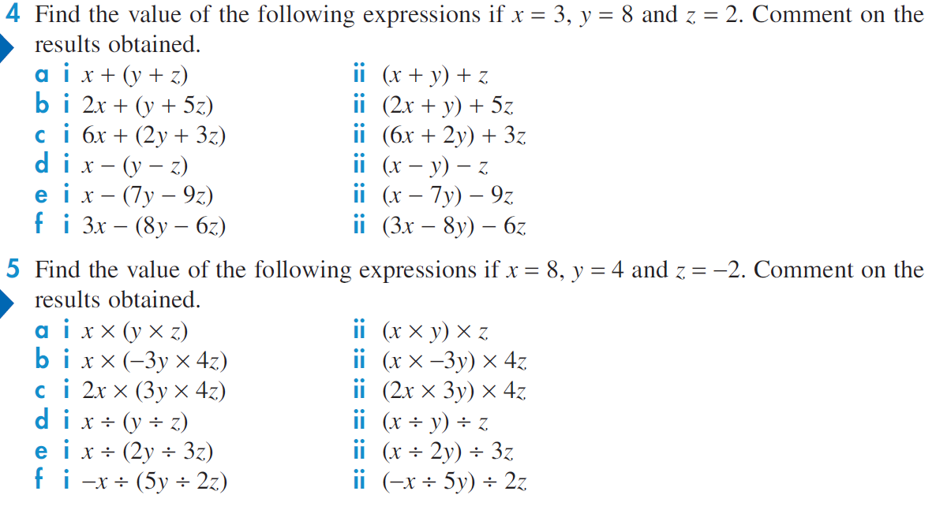
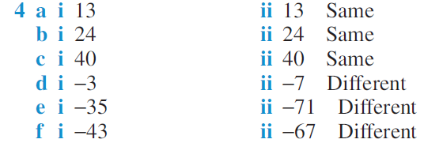

Slide 17
Identity Law
The Identity Law states that, in general,
x + 0 = 0 + x = x
x × 1 = 1 × x = x
Example:
5 + 0 = 0 + 5 = 5
3 × 1 = 1 × 3 = 3

Slide 18
Inverse Law
The Inverse Law for addition states that when a number is added to its opposite, the result is zero.
The Inverse Law for multiplication states that when a number is multiplied by its reciprocal, the result is one.

