Slide 1
Lesson 11
Similarity
Similar Figures and Scale
Testing for Similarity
3 Types of Similarity Questions

Slide 2
Similar Figures and Scale

Slide 3
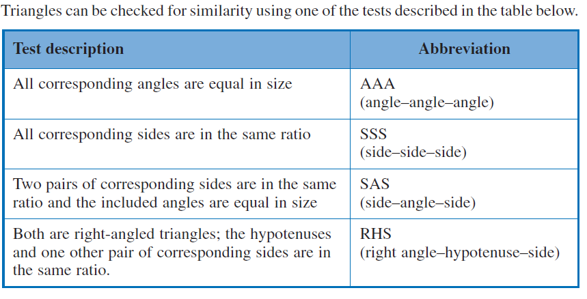
Testing for Similarity

Slide 4
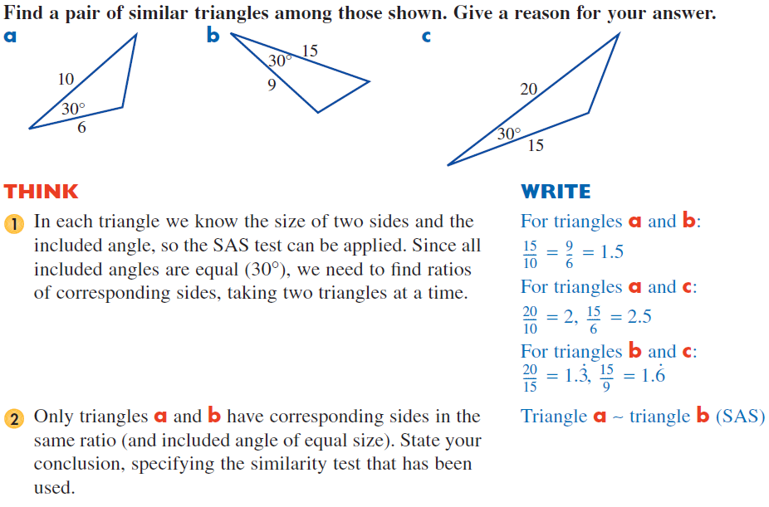
Example of Identifying Similarity

Slide 5
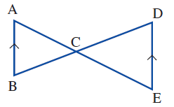
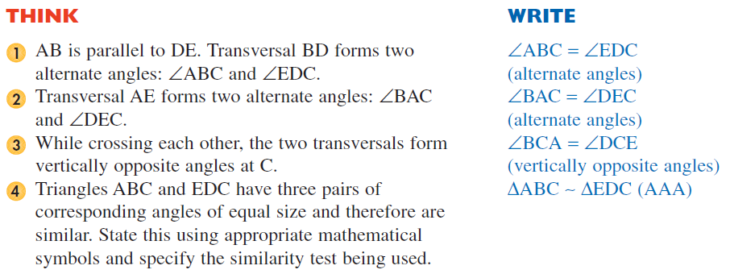
Example of a Proof with Similarity

Slide 6
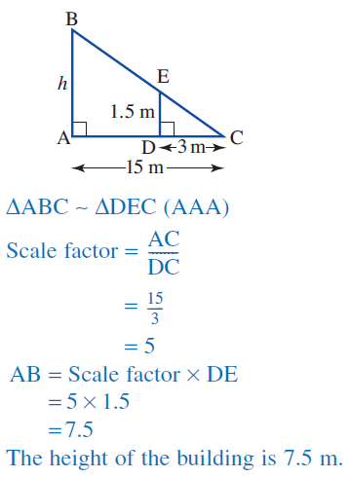
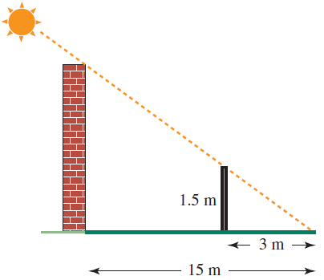
Example of Solving with Similarity

