Slide 1
Space and Geometry
Concepts and Facts
Line segment and midpoint (bisect angles and lines using compass)
Properties of triangles, quadrilaterals and polygons
Angles:
formed by intersecting lines, e.g. opposite, supplementary, complementary angles
external angles: properties of external angles of (triangles, polygons)
Congruence – SSS, SAS, ASA, RHS
Similarity - scale factor
Transformations – slide, flip, turn
Proofs:
angle properties associated with parallel, perpendicular and transverse lines and polygons, e.g. when two straight lines intersect, opposite angles are equal
sum of interior angles

Slide 2
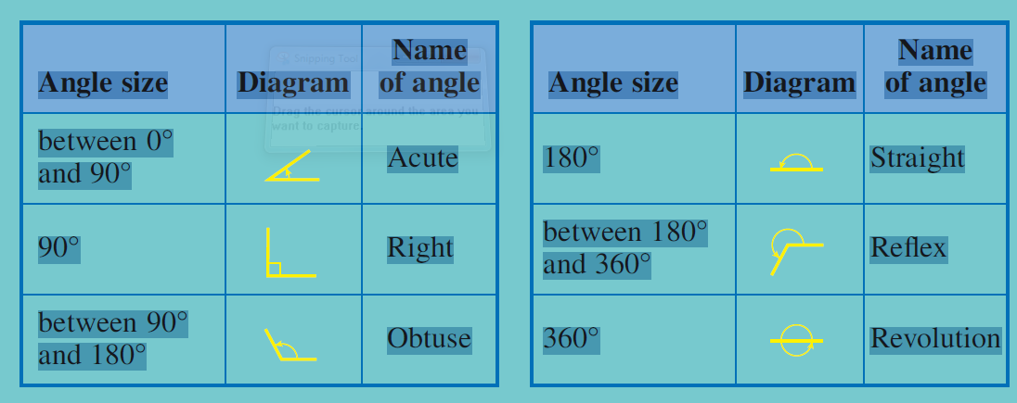
Classifying Angles

Slide 4
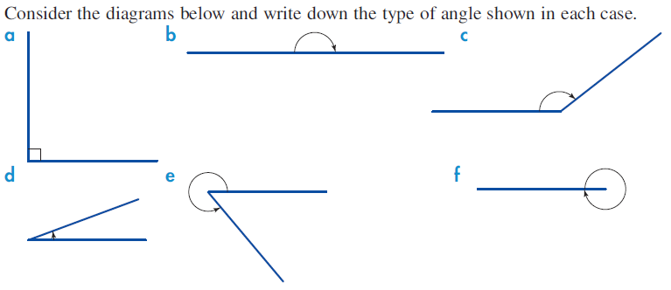

Slide 5
Naming Angles

Slide 7
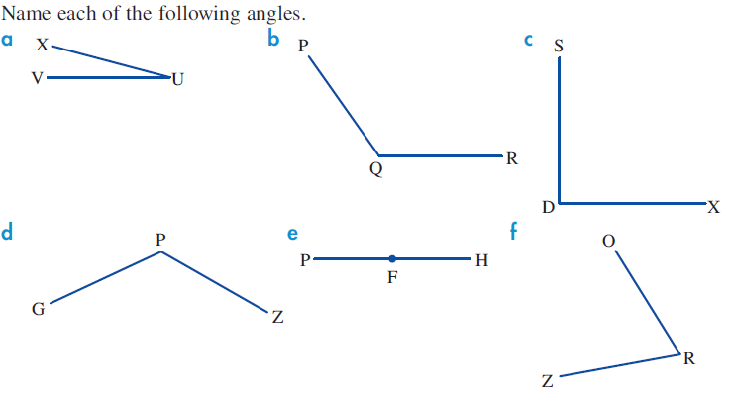

Slide 8
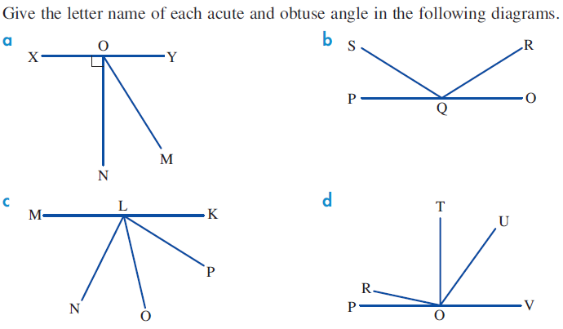

Slide 9
Calculating the Size of Angles

Slide 10
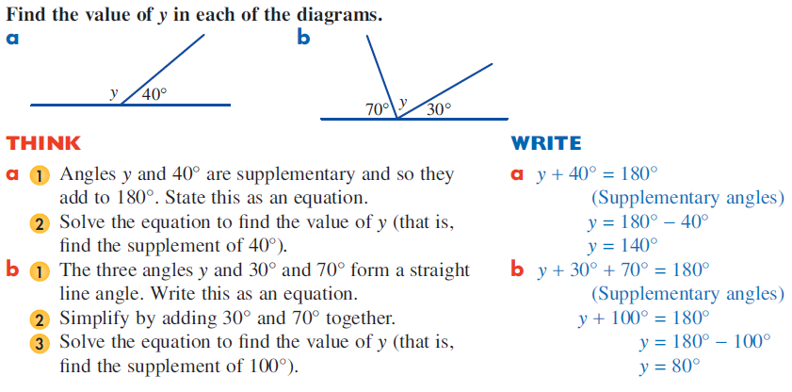

Slide 11
