Slide 1
Lesson 5
Agenda
Angles in a Polygon
Parallels and Transversals
Practice, Practice!!!

Slide 2
Angles in a Polygon

Slide 3
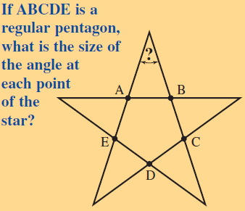

Slide 4
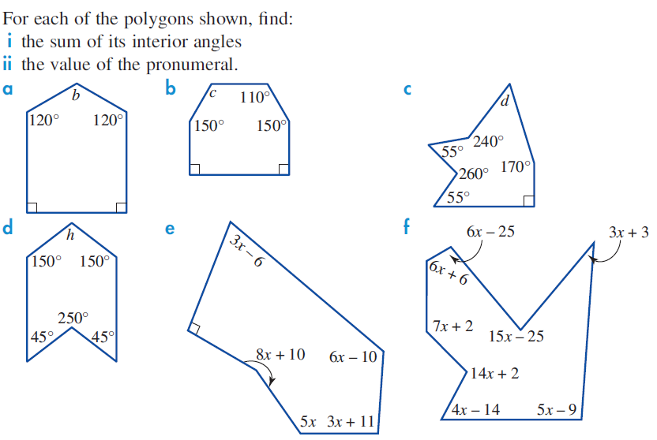

Slide 5
Angles and Parallel Lines

Slide 6
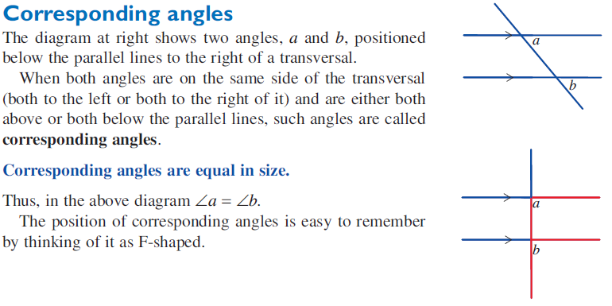

Slide 7
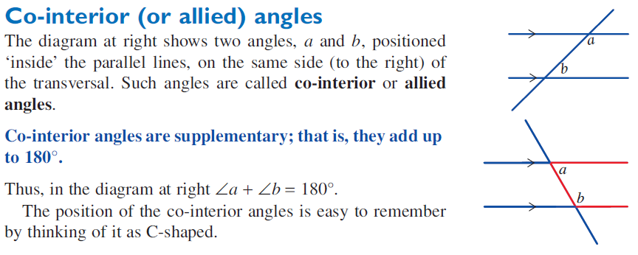

Slide 8
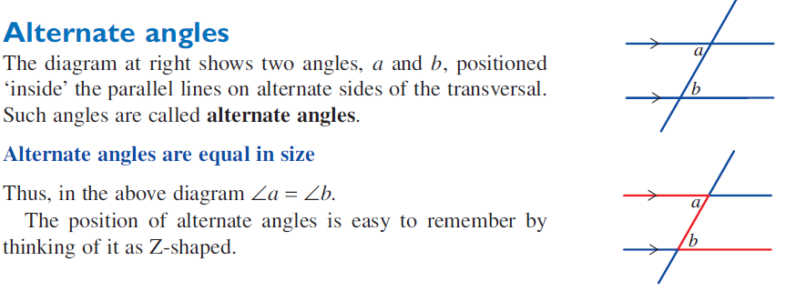

Slide 9
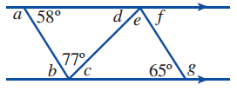
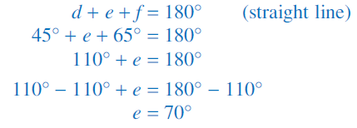

Slide 10
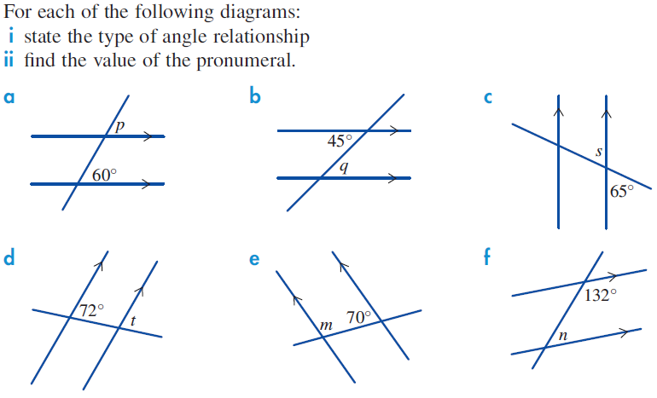

Slide 13
